Slide 1


Slide 2
Pandas
It is a most famous Python package for data science, which offers
powerful and flexible data structures that make data analysis and
manipulation easy. Pandas makes data importing and data analyzing
much easier. Pandas builds on packages like NumPy and matplotlib
to give us a single & convenient place for data analysis and
visualization work.
Two important data structures of pandas are.
Series
DataFrame

Slide 3
Pandas Series
A Series is a one-dimensional array containing a sequence of values of any data type(int, float, string list, etc) which is by default have numerical data labels starting from zero. The data labels associated with a particular value is called its index. We can imaging Panda’s Series as a column in a spreadsheet.
Index values
A | 10
B | 3
C | -10
D | 2
E | 55

Slide 4
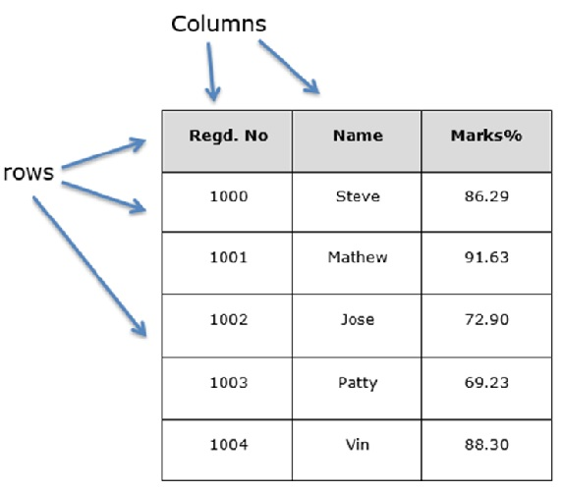
Pandas DataFrame
A Data frame is a two-dimensional data structure, i.e., data is aligned in a tabular fashion in rows and columns.
Data Frame is defined as a standard way to store data that has two different indexes, i.e., row index and column index

